Slide 1

Rigor, Relevance, and Relationships
In the Fine Arts classroom
#ModelSchools
Presented by : Mr. Jeremy Sterk

Slide 2
Getting Started
Meet Tri-County
It’s what we do
We are unique
Reaching Higher
Wrap up
Notes:
Overview slide - Objectives Pictochart here possible?

Slide 3

We are TC!
Notes:
School info and data will go here. I want to paint the picture of who we are as a school.

Slide 4
Tri-County Schools pledge to elevate and empower students to embrace challenges, optimize effort, exceed expectations, surpass goals, and reach their highest level of personal educational achievement.
Notes:
Open with an introduction about the school and what Tri-County is all about
Why is our pledge important? We do not want our students to just exist. We want them to thrive.

Slide 5
Who is Jeremy Sterk?
Notes:
Info about who I am what I teach and my roles at TC

Slide 6
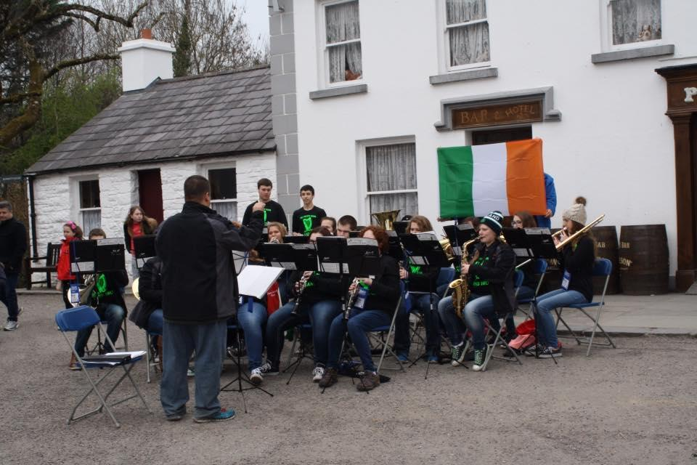
Fine Arts at Tri-County
Notes:
Music classes offered:
Visual art classes offered: 2D, 3D, digital design, ceramics
50 enrolled in art and 150 enrolled in music (up from around 75 in 2008)

Slide 7
It does apply
to you!
Notes:
Too often fine arts people sit in staff meetings and say that the teaching techniques don’t apply to them because they are “different”. Yes we are different but that does not mean that we can’t apply new techniques to our teaching. We may have to be creative, but that is what we do. When we say that doesn’t work for us we are sending the wrong message.

Slide 8
Rigor?
Relevance?
It’s what we do!
Notes:
The truth of the matter is we already a lot of rigorous quadrant D teaching in our everyday lessons. Many of the same concepts found in the Rigor/Relevance framework can be found in the National Standards for the Arts. There is a natural connection between the two.

Slide 9
Planning?
It’s a must!
Notes:
Planning is an absolute must. Too many times teachers in the fine arts fail to plan. We use the excuse that we are doing the same thing everyday or we are not able to plan because we are working on concert music or a project and have to react to what the students are doing. This sells the students short. Rigorous lessons start with good lesson planning. Planning to meet the standards is a huge step towards providing quality rigorous lessons.

Slide 10
Learning Environment
The Arts are about risk taking
Notes:
In the Learner Engagement Rubric under the well developed section of student learning/Learning Environment it tasks about risk taking and persevering through struggles. Students in the arts must take risk in order to be creative. They must be allowed to make mistakes. Then with feedback from the instructor they grow and continue to become musically indepentent.

Slide 11
Learning Environment
Performing ensembles are about teamwork and respect for others
Notes:
Students in a performing ensemble must develop a level of trust and respect for the instructor and their peers in the group. It takes everyone to make the group sound great. They must learn to build each other up to be successful

Slide 12
Meaningful Work
Presenting work
And
Looking Ahead
Notes:
One of the Indiana standards for the visual arts deals with showcasing student work. Students use the same presenting and evaluating skills taught in public speaking to present their work and ideals. Students also take the skills learned from one piece of music or art project and can look for ways to expand on that learning for the future

Slide 13
Meaningful Work
It’s in the
Interpretation
Notes:
Students must draw on previous knowledge and information about the time period and other stylistic ideals in order to create a final product. There are many ways a musician can approach a piece of music. They must draw on facts, their own creativity, and personal experience to create the best product.

Slide 14
Thoughtful Work
Self Assessment:
We do that!
Notes:
Students in the arts must constantly be self assessing their work. Some basic examples are listening for balance and blend, or intonation. Students must assess their work and then make creative decisions about where to go from their.

Slide 15
Active Participation
It’s about the students
Notes:
The arts are student driven by nature. Students are the ones creating the music with the guidance of the teacher. Students are the ones creating the art. If the students are not engaged art can not happen. Students in the arts are constantly encouraged to take ownership of the learning and actively seek ways to improve.

Slide 16
Time To Respond
Identify one thing in your standards that helps promote rigorous lessons:
https://padlet.com/sterkj/5c9eih4qb6q2
Notes:
Possible lesson example with the room

Slide 17
We’re Unique!
Notes:
The fine arts instill an attention to detail that creates a standard of excellence in our classrooms.
Students in the fine arts are in a constant pursuit of excellence in everything we do. 90% of the notes correct is not OK in music. We must strive for perfection. Music is the ultimate group project. It takes everyone in the room joining into the pursuit of excellence to acheive a positive final outcome. Successful fine arts programs need rigor.

Slide 18
Opportunities For All
Notes:
The fine arts can create a very diverse learning opportunity for all students to be successful. With good planning and research, quality lesson can be created for students with special needs. These students deserve rigorous and relevant lessons as well. Many times we get the relationship part right with these students, but fall short when it comes to creating rigorous meaningful lessons. Highlight other ways music provides opportunities to create meaningful rigorous lessons for all students

Slide 19
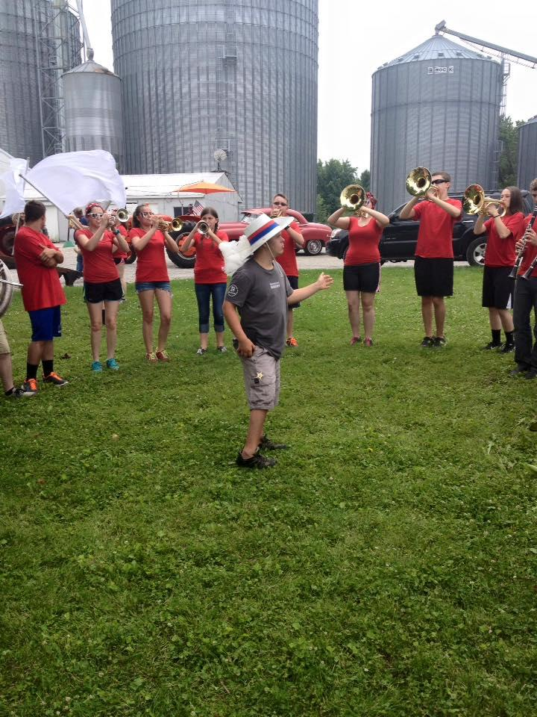
Meet Isaac
Notes:
Use Isaac to demonstrate the points made about rigorous lessons for all students

Slide 20
What makes you the difference?
#ModelSchools
Notes:
At this point I will ask people to identify one thing they are already doing well to create rigorous and relevant lessons for all of their students.

Slide 21
Time to REACH Higher!
Notes:
Now the focus will shift to ways we can improve our lessons to create more rigorous and relevant quadrant D learning in the fine arts classrooms. I will highlight a few things that have worked for me including:
Careful lesson planning based on data
Collecting data and sharing it with the students
The power of collaborating with others
The use of technology to help collaborate
Making connections
Inspiring Creativity
And the power of relationships
This is the where do we go from here part

Slide 22
Did I mention planning?
Notes:
Just a brief reminder that great lessons don’t just happen. They are a product of careful planning.

Slide 23
Data is a nice four letter word
Pass it on
Notes:
Data is not the enemy. I believe collecting appropriate data is crucial to providing great lessons that your students really need. I will give some examples of how I collect data including; judges comments, planning test, music played, guest conductor comments, and self evaluations. I also feel it is very important to share this data with my students. I like for my students to understand why I am planning certain activities and what is the goal I hope to accomplish with them. This helps the students understand the relevance of the activities that we are doing.

Slide 24
Find A Friend
Notes:
You don’t have to reinvent the wheel and you are not alone. Seek out others to collaborate with. Everyone needs that person to bounce ideas off of. That may be someone in your building or from another school. Seek out professors from local universities or other teachers that you respect. I have found that most great educators did not start out amazing, but put in a lot of hard work to get there. They are often more than willing to share their expertise with you. Get out and observe, send emails, ask questions, borrow.

Slide 25
Technology is a tool
Not the answer
Notes:
Here I will highlight a few of the ways that I use technology to assist in creating rigorous and relevant lessons for my students.
One example is programs like smart music, but you have to go above and beyond
Also the use of Google to communicate and create topic calendars
Use of skype, facetime and other programs to have others assess and give feedback
The use of videos and digital portfolios for self assessment and to track growth

Slide 26
Make Connections
Notes:
I feel it is very important for students to understand that there is a purpose for everything that we do. Constantly make connections between the activities that you do in the classroom. For example make connections between warm up activities and the performance music, or connect a drawing technique learned earlier to a larger project being worked on by the student.

Slide 27
Inspire Creativity
Notes:
This should seem like a no brainer for the fine arts department, but too often we feel the pressure to prepare for a concert or an art show and we tell them how we want something rather than letting them explore and create. What are we doing in our classrooms to foster creativity and allow students to make artistic decissions?

Slide 28
Relationships:
More than just feelings
Notes:
I believe that building relationships is a key element in a successful fine arts program. The demands and performance schedule of my program means that I spend a lot of time with my students. There needs to be a level of trust between us. Students need to trust that teachers are working to plan quality lessons that will make them better when they leave than when they came in. Teachers need to trust the students enough to allow them to create moments on their own and continue to grow on their ownl
Relationships also applies to developing quality professional relationships with other teachers and administrators.

Slide 29
Time to respond
One take away or thing you will try
https://padlet.com/sterkj/zkye629n0pan

Slide 30
Works Consulted:
International Center for Leadership in Education, Rigor, Relevance, Framwork.
National standards for music education 2014
https://nafme.org/my-classroom/standards/core-music-standards/
National core arts standards
http://www.nationalartsstandards.org
Notes:
This page will be cleaned up. And cited correctly

Slide 31
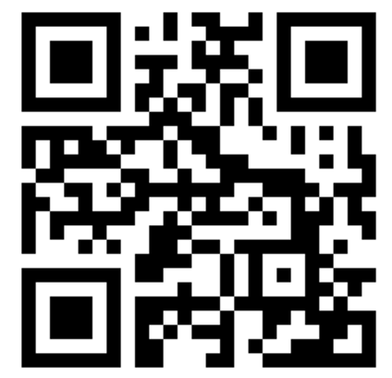
SHARE YOUR FEEDBACK!
Through the APP
https://tinyurl.com/n57tofo
Or QR Code
#ModelSchools

